Slide 1


Short Story review of
Large Language
Models: A Survey

Slide 2
LLMs are large-scale, pre-trained, statistical language models based on neural networks. The development of LLMs was made possible in 4 waves: Statistical Language Models, Neural Network Language Models, Pretrained Language Models, and finally LLMs.
For Statistical Language Models the best was the Markov Chain Models (n-gram models) which predict the next word based on the preceding n words. The problem with this approach was data sparsity.
Then came the NLMs, which deal with data sparsity by mapping words to low-dimensional continuous vectors. This approach enabled semantic search capabilities. These are mainly task-specific models.
Then, Pretrained Language Models, these models are task-agnostic, they follow the pretraining and fine-tuning paradigm.

Slide 3
LLMs are transformer-based language models with tens of thousands of Billion parameters. These exhibit better language understanding and generational capabilities from PLMs and have emerging abilities that are not there in PLMs:
1) In-context Learning
2) Instruction Following
3) Multi-Step Reasoning

Slide 4
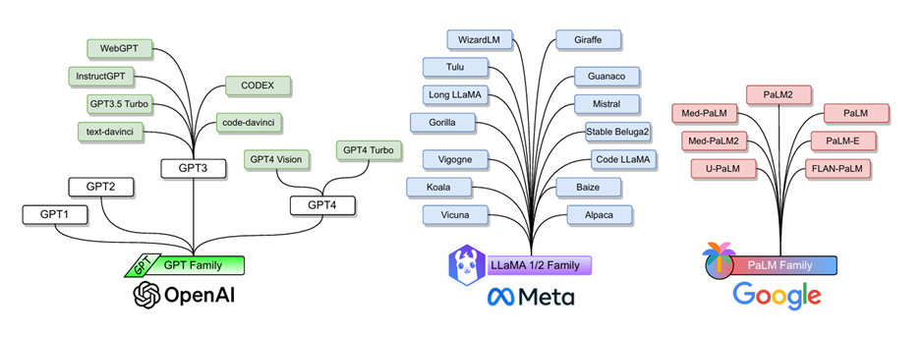
GPT Family:
Decoder - Only Architecture
Application Diversity
LLaMA Family:
Open-Source Accessibility
Enhanced Design and Performance
PaLM Family:
Scale and Training Efficiency
Advanced Fintuning Techniques

Slide 5
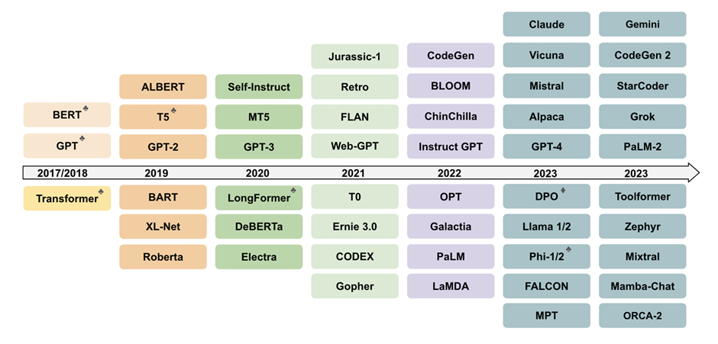
LLM Architectures:
Transformer: Works on self-attention to preserve long-term contextual attention.
1) encoder-only: Good for tasks based on inputs like text classification (BERT)
2) decoder-only: Generative Models (GPTs)
3) encoder-decoder: Generating something based on the inputs (Translation)

Slide 6
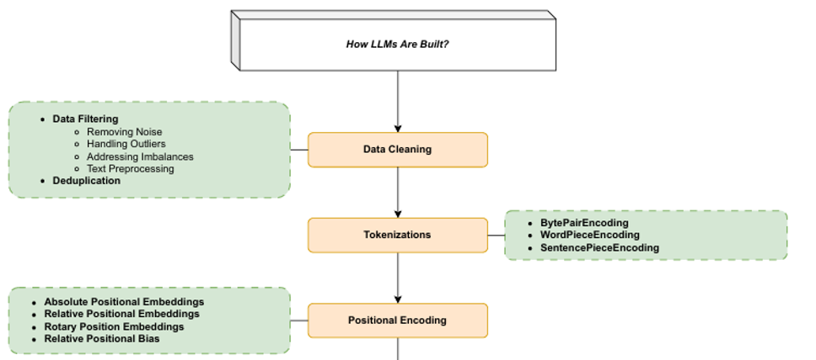

Slide 7
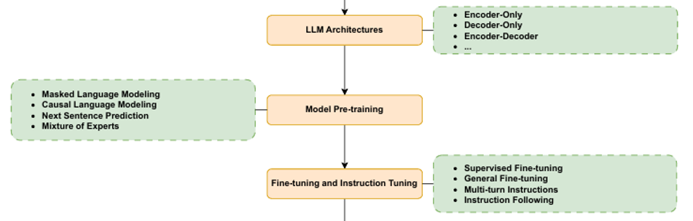

Slide 8
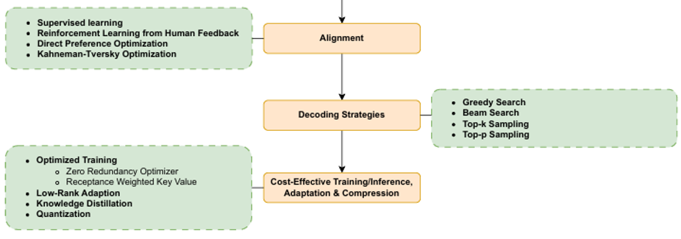

Slide 9
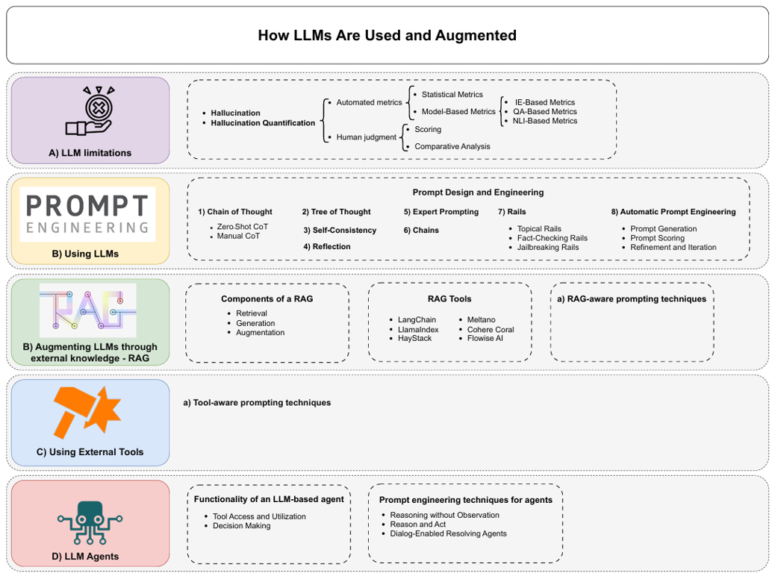

Slide 10
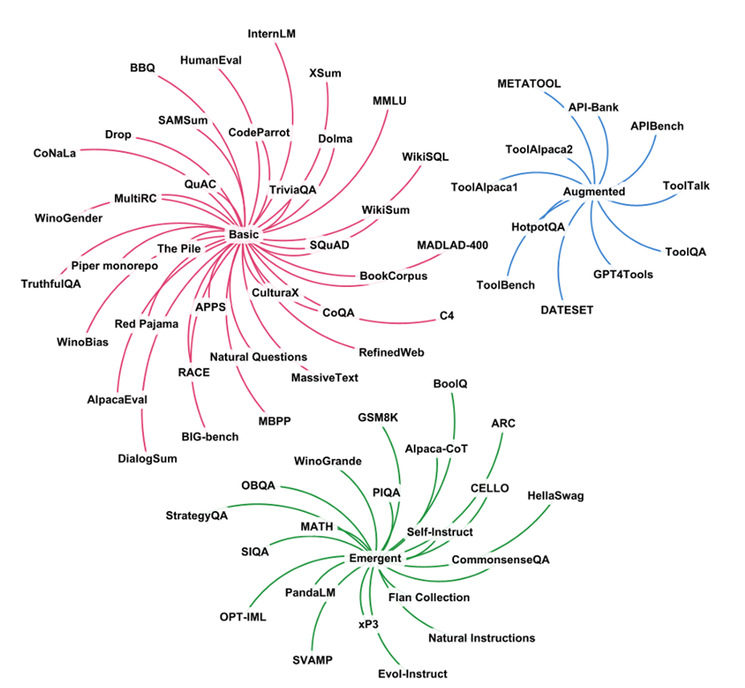
Datasets:
Red (Basic): These are foundational datasets that typically involve tasks such as reading comprehension, information retrieval, and basic question answering.
Blue (Augmented): Augmented datasets involve tasks that require the LLM to interface with external knowledge sources or tools.
Green (Emergent): These datasets are designed to assess higher-level cognitive tasks such as problem-solving, reasoning, and creative generation.

Slide 11
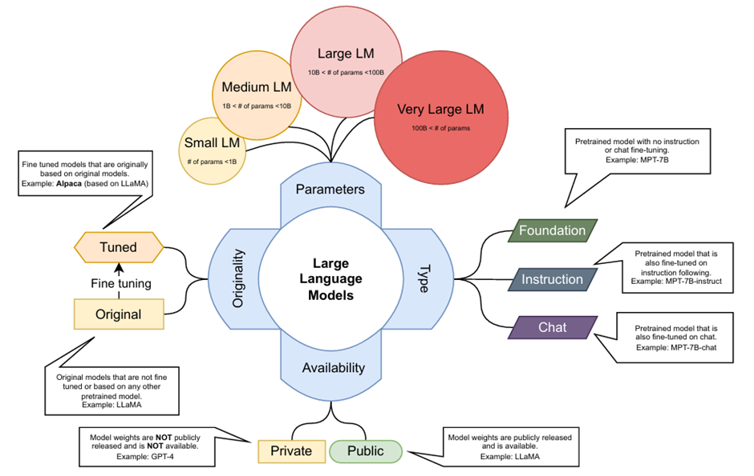

Slide 12
Metrics for Evaluating LLMs
• Classification Metrics: Accuracy, precision, recall, F1-score, etc., are used for tasks like sentiment analysis and multi-choice question answering, where responses are either true or false.
• Generative Task Metrics: Open-ended tasks, such as code generation, require specialized metrics like PASS@k, which measures how many generated code solutions pass a set of test cases.

Slide 13
• Exact Match (EM): Used for tasks where responses must match predefined answers exactly, similar to accuracy in some contexts.
• Human Equivalence Score (HEQ): Evaluates answers based on whether they surpass an average human F1 score.
• Text Generation Metrics: ROUGE, BLEU for tasks involving text similarity; advanced metrics like PARENT and Knowledge F1 assess the structure and factual content.
• Generative Evaluation Metrics: These metrics evaluate outputs using another LLM, focusing on aspects not captured by simpler metrics like n-grams.

Slide 14
Performance of LLMs
Code Generation: Evaluated using PASS@k and accuracy; models are tested for both the ability to generate syntactically correct code and to functionally solve programming problems.
Reading Comprehension and Reasoning: Models are tested on datasets like SQuAD, RACE, and others with metrics such as F1-score and EM, focusing on the model's ability to parse and understand textual information correctly.
Commonsense and Logical Reasoning: Evaluated on benchmarks like HellaSwag and PIQA, which require models to apply broad general knowledge and logical reasoning.

Slide 15
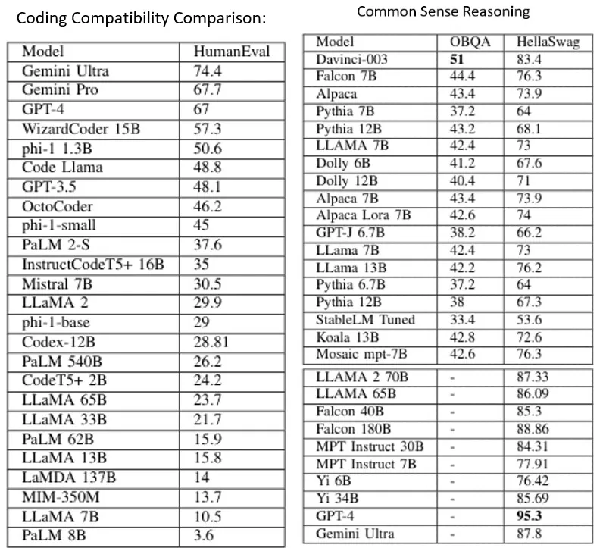

Slide 16
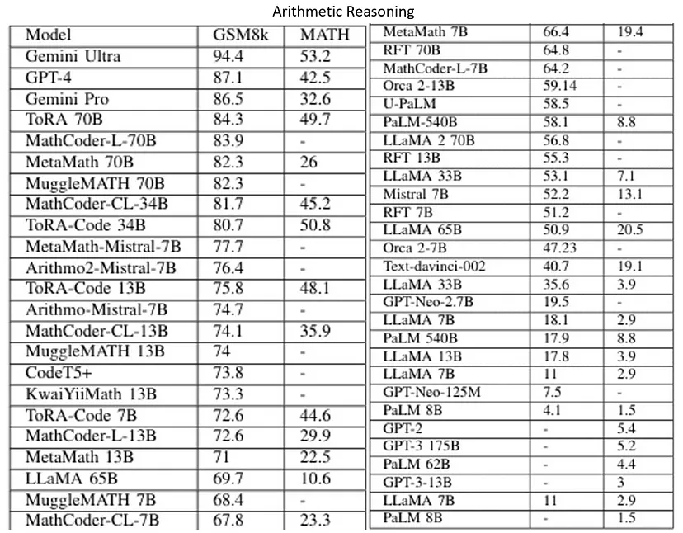

Slide 17
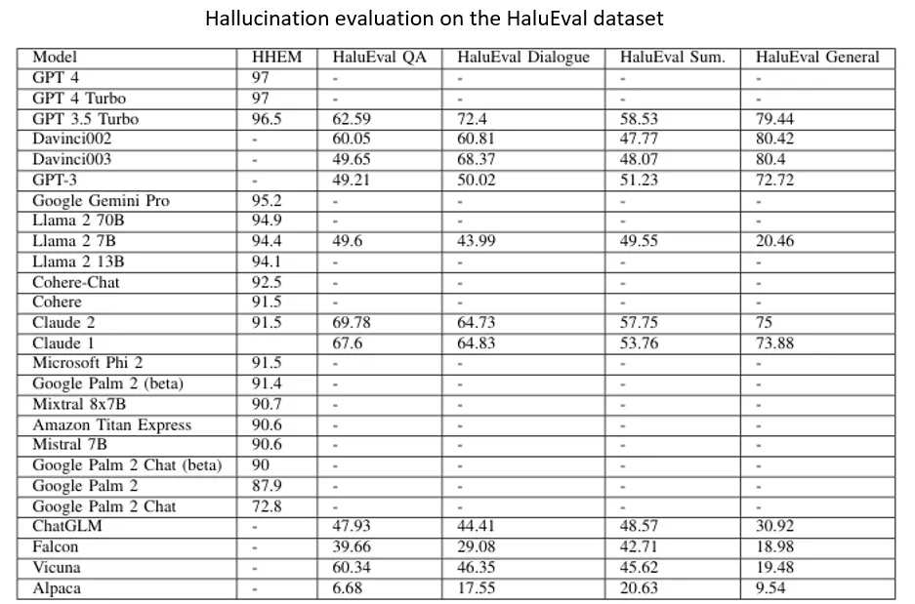

Slide 18
Future Scope and Research Areas
1. Smaller and More Efficient Language Models: The need for cost-effective Small Language Models (SLMs) as alternatives to larger, costly models like GPT-4 is highlighted. Techniques like parameter-efficient fine-tuning and distillation are important for developing these smaller models.
2. New Architectural Paradigms: There's an exploration beyond Transformer blocks to post-attention models like State Space Models (SSMs). These include architectures like Monarch Mixer and mechanisms like Mixture of Experts (MoEs) which address the need for processing longer contexts.

Slide 19
3. Multimodal Models: Future LLMs are expected to become multimodal, handling diverse data types like text, images, and videos in a unified manner, which will enhance their applications across various fields.
4. Improved LLM Usage and Augmentation: Research in advanced prompt engineering, the use of tools, and augmentation techniques is crucial for addressing LLM limitations such as hallucinations. This includes the development of LLM-based systems for personalized interactions and multi-agent systems that may lead to AGI.
5. Security and Ethical/Responsible AI: Ensuring the robustness of LLMs against adversarial attacks and ethical concerns such as biases and responsible handling of sensitive information is an ongoing area of research. As LLM usage increases, so does the importance of ensuring their security and ethical behavior.

Slide 20
Thank You :)

